Slide 1
Equality and diversity analysis of performance management outcomes
Sumit Rahman, Department for Business, Innovation and Skills
Notes:
I am going to be talking about the E&D analysis of my department’s performance management outcomes that I do for HR.
Everyone put their hands up. Now put your hands down if you are a civil servant.

Slide 2
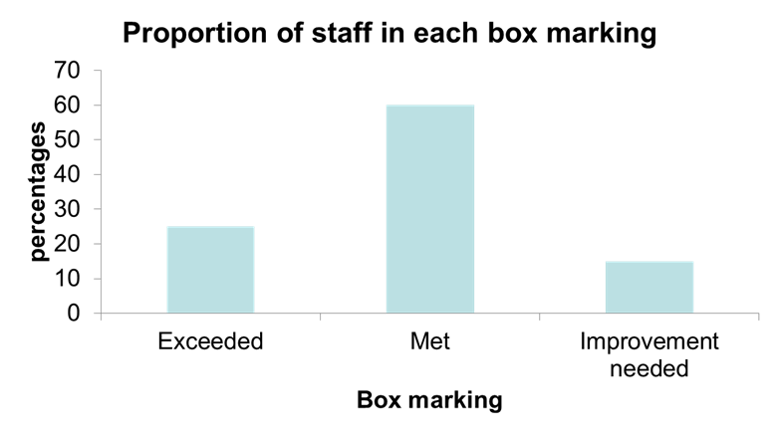
The problem
Notes:
We have this – extremely popular, highly motivating, unbureaucratic – performance management system. Everyone gets put into one of three outcomes: gold/silver/bronze, BIS uses Exceeded/Met/Improvement Needed.
We also have something that looks awfully like a quota, but isn’t. Depts have discretion to set this guided distribution. They are all mostly similar to this, with the middle being the dominant mode (50% or more) and some asymmetry with the worst outcome being least likely.
By the way, numbers here and throughout the presentation are made up. Do not think you can infer anything about BIS’s results, anything about the existence of an effect, the size of an effect, even the direction of an effect, from anything you see today!

Slide 3
The problem
What impact do ‘demographic’ characteristics such as age, gender, grade have on your chances of getting the various performance management outcomes?
Effects might be confounding
Notes:
My colleagues in HR know their way round Excel well enough to produce pivot tables, so we can look at marginal distributions one characteristic at a time but this is potentially misleading.

Slide 4
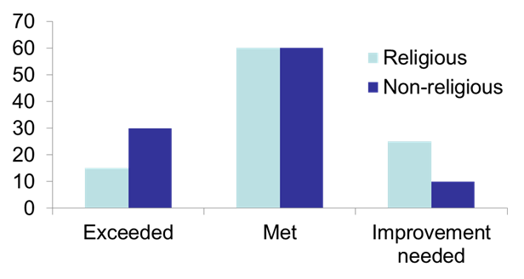
Confounding effects
 | Probability of top rating
Religious | 15%
Non-religious | 30%
Marginal distribution suggests there is a religion effect
Notes:
This looks like there is a religion effect. Religious people getting worse ratings.

Slide 5
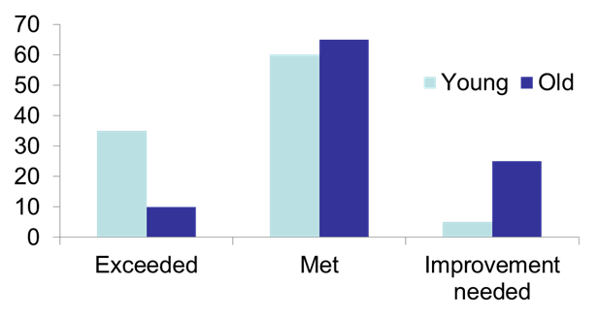
Confounding effects
Marginal distribution suggests there is an age effect
 | Probability of top rating
Young | 35%
Old | 10%
Notes:
And it looks like there is an age effect too – older people getting worse ratings (and getting angry and deciding to vote for Brexit as a result?).

Slide 6
Confounding effects
 | Probability of top rating
Religious | 15%
Non-religious | 30%
 | Probability of top rating
Young | 35%
Old | 10%
 | Young | Old
Religious | 5% | 20%
Non-religious | 20% | 5%
Notes:
But look at the joint distribution of age and religion. Strong association between the two.
So: do we have a real age effect, and is this joint distribution inducing an apparent religion effect?
Or is it the other way round: a real religion effect, an apparent age effect?
Or do we have two real but moderate effects, which are then reinforcing each other to look bigger than they really are?
Or are they both apparent effects being driven by a real, hidden, third confounding variable??
We need to do some multivariate analysis!

Slide 7
Regression
I use ordinal logistic regression to tease apart and quantify the separate impacts
Notes:
I use ordinal logistic regression.

Slide 8
Regression
I use ordinal logistic regression to tease apart and quantify the separate impacts
Because performance management outcomes are categorical
Notes:
Ordinary linear regression is definitely NOT an option here.

Slide 9
Regression
I use ordinal logistic regression to tease apart and quantify the separate impacts
Because performance management outcomes are ordered (exceeded, met, improvement needed)

Slide 10
Regression
I use ordinal logistic regression to tease apart and quantify the separate impacts
Multinomial logistic regression ignores the ordered nature of the outcomes and is less parsimonious (more parameters)
Notes:
You can use probit regression instead of logistic.
You can use multinomial instead of ordinal.
The main purpose of this paper is to introduce the method of obtaining corrected probabilities – easy to adapt what you are seeing today to the probit case or the multinomial.

Slide 11
The real problem
Not disabled | 0
Disabled | -1.21
Prefer not to say | 0.05
Female | 0
Male | 0.15
Cut 1 | -1.02
Cut 2 | 1.87
Notes:
Let’s suppose we arrive at this model. My made up example is simpler than I typically get in real life.
In a sense, after we have decided to use this model, THIS is the answer to our question. Easy enough to write some commentary.

Slide 12
The real problem
Not disabled | 0
Disabled | -1.21
Prefer not to say | 0.05
Female | 0
Male | 0.15
Cut 1 | -1.02
Cut 2 | 1.87
What is a logit? Are these numbers BIG or small?
Notes:
BUT although we have a relative sense of effect sizes, I don’t think this gives us – or my expected customers – a real sense of what the effect looks like.
If we had more time I’d treat you to a rant about odds ratios and why I don’t think they are appropriate to report. Today let’s just say that I want to give an answer using the language of probabilities and not odds.

Slide 13
The real problem
Once the model has been fitted, there is a function P( ) which turns a set of demographic values into a probability distribution
P(disabled, female) -> [10%, 56%, 34%]
P(not disabled, female) -> [27%, 60%, 13%]
Notes:
Having fitted the model, we can obtain fitted probabilities given any combination of demographic characteristics (of the ones in our model). These are the probabilities for gold, silver and bronze.
This here illustrates the disability effect, but only for females. There will be a different disability effect for males.
This is so EVEN THOUGH THERE IS NO INTERACTION EFFECT BEING MODELLED. The problem is that our model, based on odds, has different impacts on probabilities depending on the value of the probabilities being impacted.
Not a criticism of odds by the way – using odds allows us to fit what is a pretty simple model.

Slide 14
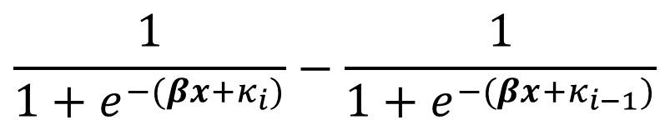
The real problem
Once the model has been fitted, there is a function P( ) which turns a set of demographic values into a probability distribution
Probability of getting mark i
Notes:
Don’t get hung up on understanding the precise formula. Point is…

Slide 15
The real problem
I want to get away from the full set of demographic characteristics in this expression and focus on one at a time
Probability of getting mark i
Notes:
…I want to focus on one characteristic at a time.

Slide 16
The real problem
I want to get away from the full set of demographic characteristics in this expression and focus on one at a time
Why?
Because the estimated coefficients are ‘pure’ effects. We have dealt with the confounding issue by fitting our model.
Time to interpret the effect!

Slide 17
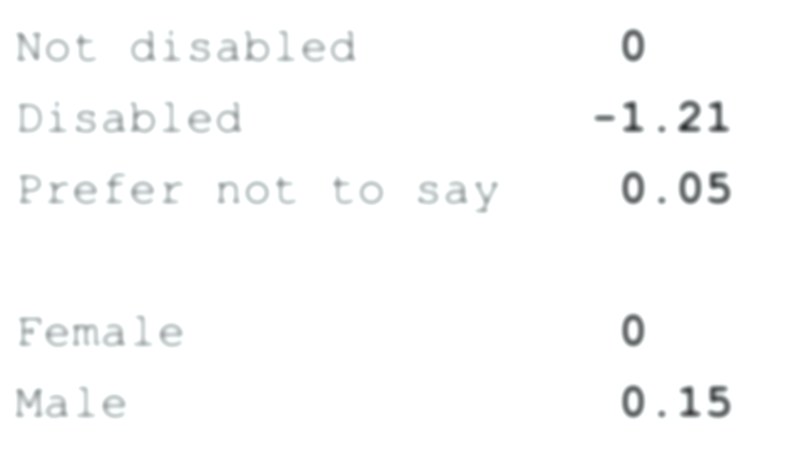
Interpreting the effect
We had a male coefficient of 0.15 – this is a number on the logit scale
Notes:
Let us concentrate on the male impact for what follows

Slide 18
Interpreting the effect
We had a male coefficient of 0.15 – this is a number on the logit scale
If the probabilities for a female are given by P(x), then the corresponding probabilities for a male with the same other demographics will be P(x + 0.15)
I don’t really care what x is
Notes:
Go back to previous slide and say for female non-disabled X=0 and for female disabled X=0-1.21, for male PNS X=0.15+0.05 etc.
In my microdata there are only three values of X possible, corresponding to the three different disability statuses. So X could be zero, -1.21, 0.05
To help abstract this, imagine a group of women with a variety of disability statuses. The average X value could be anything (between -1.21 and 0.05). Imagine clicking your fingers so they turn into men, without changing their disability statuses. The average X value would be X+0.15.
The gender effect would be the difference in the two probability distributions.

Slide 19
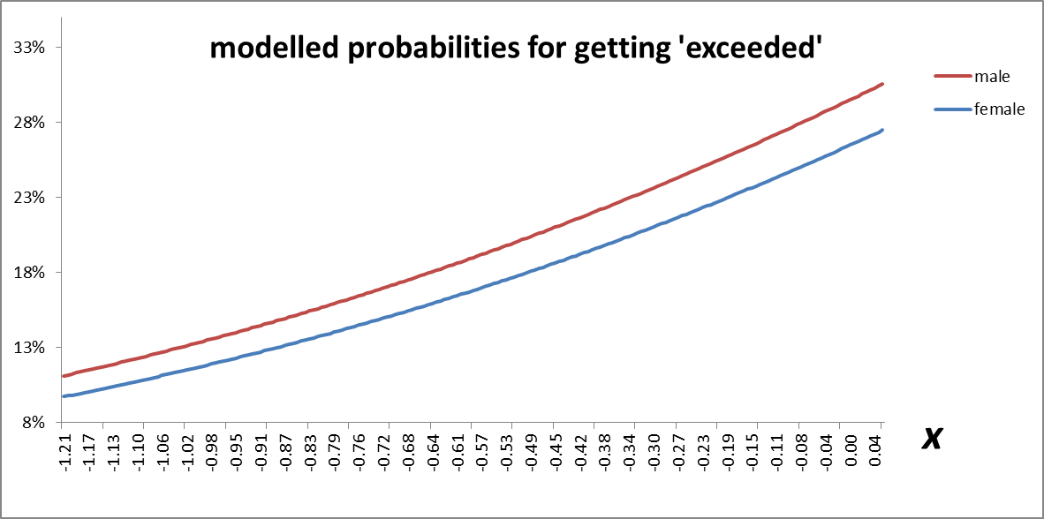
Interpreting the effect
Notes:
The male line is the female line translated to the left 0.15 units.
Could also put the met and improvement needed graphs below this, all with the same X axis. Each vertical slice of this specifies a new set of probabilities.

Slide 20
Interpreting the effect
The male impact is +1.4% for disabled colleagues, +3.0% for non-disabled colleagues, and +3.1% for PNS
Notes:
Different impacts on the probability scale depending on what the starting probability is. This 1.4% difference is for disabled staff and corresponds to when X=-1.21. This oval here is for X=0, for non-disabled staff.
We have a FAMILY of probability distributions, each corresponding to a vertical slice of this graph (and the graphs for ‘met’ and ‘improvement needed’, on the same x-axis). The family has infinitely many members, indexed by this number X. Each family member consists of a set of probabilities, each consistent with the effects estimated in our model fitting process.
Each family member is equally valid in my eyes, but I should pick out a single member that best meets some criterion that is important for my purposes.

Slide 21
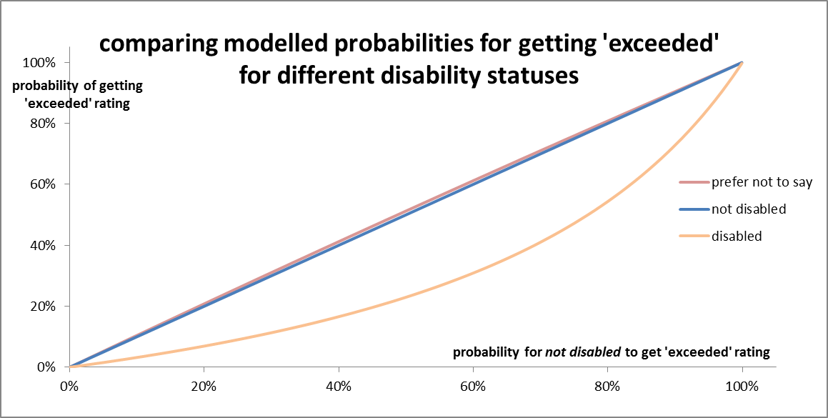
Interpreting the effect
Notes:
[SKIP THIS]

Slide 22
Interpreting the effect
This is what -1.21 on the logit scale looks like. And what +0.05 looks like – if you can see it!
Notes:
[SKIP THIS]

Slide 23
Selecting one member of the family
“I am on ill terms with no one member of my great family” – Dickens, Master Humphrey’s Clock
“If you cannot get rid of the family skeleton, you might as well make it dance” – George Bernard Shaw
Notes:
The Dickens quote describes the fact that as far as I am concerned, all members of the family are equally valid as ways of illustrating the modelled effect. [There is no restriction on X – it can be any number on the real line]
We can use this versatility to arrive at a specific member of the family that best suits our purpose. We have tools for making the whole of the family dance for us.

Slide 24
Selecting one member of the family
Suppose… | X=0
 |  | Exceeded | Met | Improvement needed
P(X) gives us: | Female | 27% | 60% | 13%
Notes:
X=0 happens to correspond to female non-disabled – but I don’t really care anymore about interpreting X.
[Might need to point out it says X=0 on the top row if not legible]

Slide 25
Selecting one member of the family
Suppose… | X=0
 |  | Exceeded | Met | Improvement needed
P(X) gives us: | Female | 27% | 60% | 13%
P(X+0.15) gives us: | Male | 30% | 59% | 12%
Notes:
Here is the gender effect for this particular member of the family (X=0).
In a world where the only effect is the gender one, this implies that for BIS as a whole the probability of exceeded will be somewhere inbetween 27 and 30%.
I know from my dataset what the female/male mix is!

Slide 26
Selecting one member of the family
Suppose… | X=0
 |  | Exceeded | Met | Improvement needed
P(X) gives us: | Female | 27% | 60% | 13%
P(X+0.15) gives us: | Male | 30% | 59% | 12%
 | BIS (implied) | 28% | 59% | 12%
We can work out the implied distribution because we know the female/male distribution in BIS (in our example, 45%/55%)
Notes:
This is what I call the implied distribution. How does it compare with the ACTUAL distribution in BIS?

Slide 27
Selecting one member of the family
Suppose… | X=0 | d=0.002
 |  | Exceeded | Met | Improvement needed
P(X) gives us: | Female | 27% | 60% | 13%
P(X+0.15) gives us: | Male | 30% | 59% | 12%
 | BIS (implied) | 28% | 59% | 12%
 | BIS (observed) | 25% | 60% | 15%
Notes:
In this case it is pretty close.
How can we quantify this? I have used the sum of squared differences. 3% squared plus 1% squared plus 3% squared gives you d=0.002 – d is my distance function.
Other distance functions are available. But this particular one is good, I think, because it penalises big differences, even at the cost of introducing some smaller differences in other places.

Slide 28
Selecting one member of the family
Suppose… | X=1 | d=0.108
 |  | Exceeded | Met | Improvement needed
P(X) gives us: | Female | 50% | 45% | 5%
P(X+0.15) gives us: | Male | 53% | 42% | 5%
 | BIS (implied) | 52% | 43% | 5%
 | BIS (observed) | 25% | 60% | 15%
Notes:
We can do the same thing for a different member of the family, X=1
In this case the implied distribution is way off, and d is larger at 0.108
Can we improve on d=0.002? Let’s pick another number…

Slide 29
Selecting one member of the family
Suppose… | X=-0.2 | d=0.000
 |  | Exceeded | Met | Improvement needed
P(X) gives us: | Female | 23% | 61% | 16%
P(X+0.15) gives us: | Male | 26% | 61% | 14%
 | BIS (implied) | 24% | 61% | 15%
 | BIS (observed) | 25% | 60% | 15%
Notes:
Here is family member X=-0.2
The implied distribution is now very close to the observed distribution, and d equals zero to 3 d.p.

Slide 30
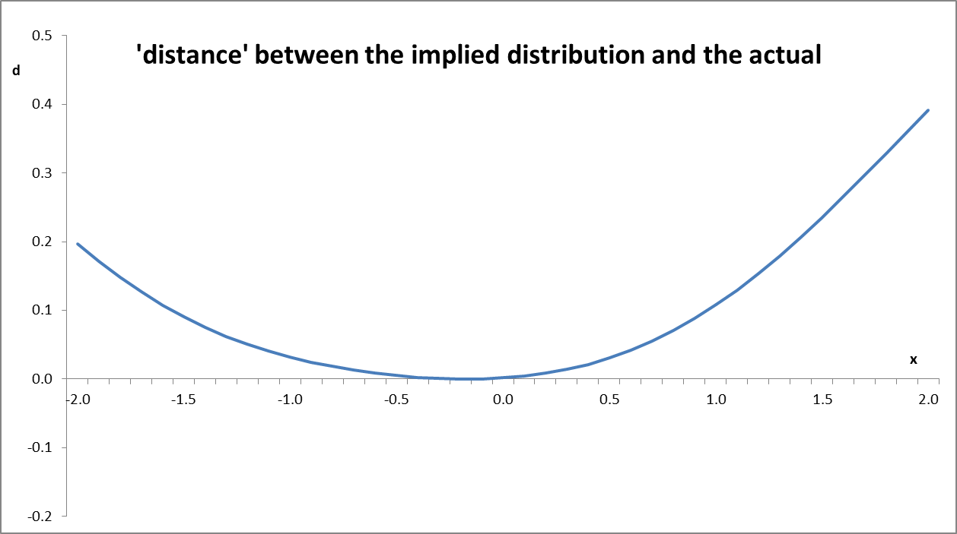
Selecting one member of the family
Closest we can get is here: x=-0.174
Notes:
So the family member to pick is the one that minimises d.
Note that this is a turning point, not a root.
Highly unlikely that we could literally get to d=0, with this distance function. And negative values are impossible, as they should be with any sensible distance function.

Slide 31
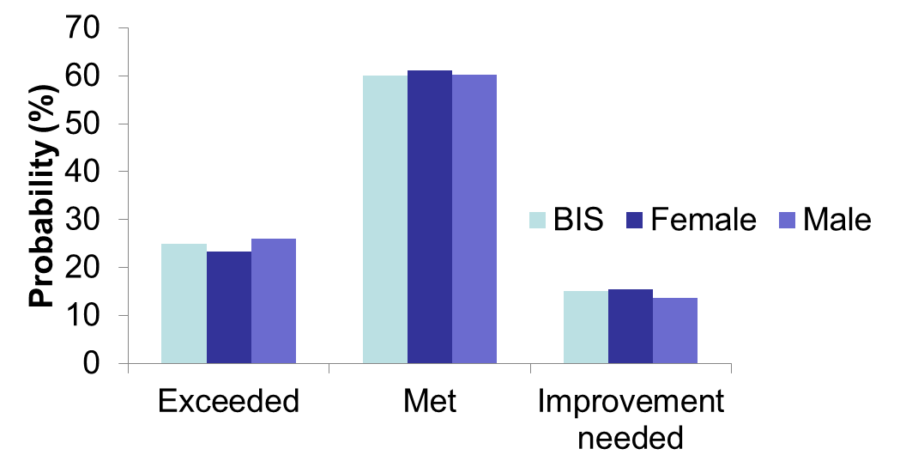
The answer – corrected probabilities for gender
The distribution for females and males are entirely consistent with the model and, combined, agree closely with the overall departmental distribution. These are what we describe as the corrected probabilities
Notes:
The distribution for females and males are entirely consistent with the model and, taking account of the relative proportions of women and men, agree closely with the overall departmental distribution. These are what I describe as the corrected probabilities.
The purpose of this analysis is to show the difference between women and men (and similarly for the other demographics). The probabilities here are consistent with the results of the model that is primarily there for estimating this difference. No compromise on this score. Given this, we’ve gone for the family member that is close to the observed overall distribution. When I report this to BIS HR, it is the target distribution and not the implied distribution that I graph.
This is what a 0.15 effect looks like in the context of the overall BIS distribution.
[Now might be a good time to talk about when you have poor model fit]

Slide 32
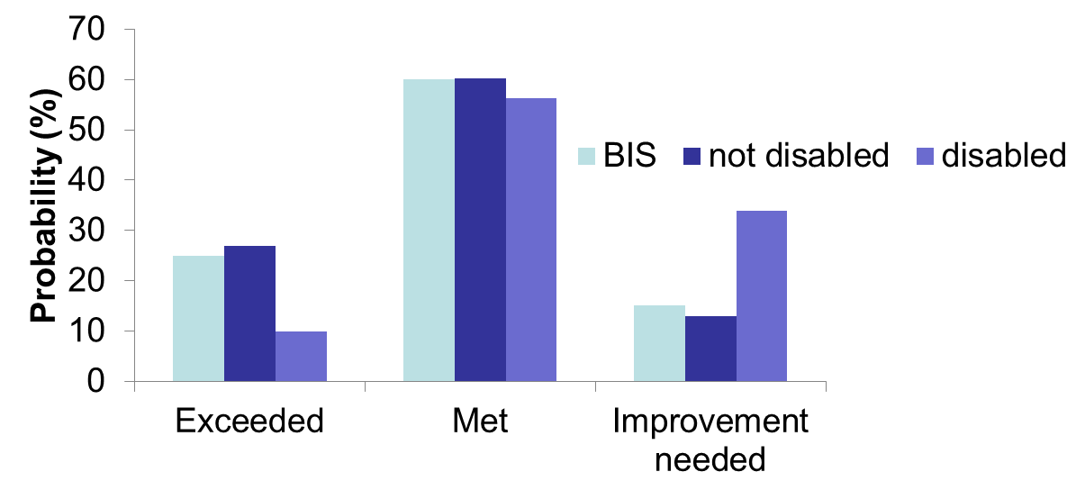
The answer – corrected probabilities for disability
This is what a -1.21 effect looks like
Notes:
Here’s what happens for the case of disability. I’ve not included PNS in the chart, but that category is observed in the dataset and included in the calculation of implied distributions and are part of the family.
You can see that a 1.21 effect size clearly has a visible impact on probabilities. Note that the target distribution is very close to the not disabled distribution, because that category dominates amongst disability statuses – 90% of BIS in my toy example are not disabled.

Slide 33
Sharing the method
I have automated much of this process by writing some functions in R
Need to fit the model using the polr function in the widely used MASS package
Notes:
I want to say a bit about how to share this methodology more widely.
I have written an R package that spits out the corrected probabilities for you, so long as you give it the microdata and the explanatory variables you want to be modelled.

Slide 34
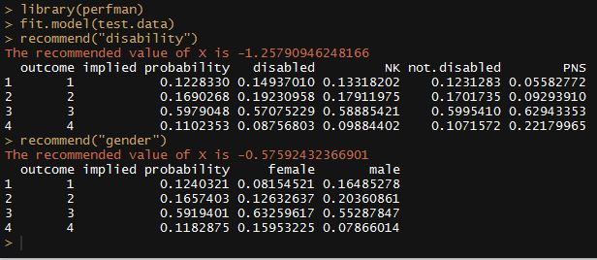
Sharing the method
Notes:
The fit.model command fits the model using the polr function from the MASS package. As currently written the data set for fit.model needs to be in a pretty specific format. My package is not terribly user-friendly. In practice your exploratory model fitting needs to take place first. I did it in Stata, though it could be done in R pretty easily.
Note that the family member X value is stated though it doesn’t really need to be reported to anyone.
Notice too that here we have four outcomes not three. Because BIS actually split the middle category into two for internal purposes. Not so much Gold Silver Bronze, as 1st 2:1 2:2 3rd
When this happened my use of ordinal logistic regression was vindicated – on multinomial my number of new parameters to estimate would be about a dozen. For ordinal it is ONE

Slide 35
Sharing the method
The code is available on GitHub, a popular and free repository
I have created a simple R package and stored it in GitHub, which means it is very easy to install it for your own use:
> install_github(“sumitrahman/perfman”)
> library(“perfman”)
Notes:
You will need the devtools package for ‘install_github’ to work
Hadley Wickham’s R Packages is what I used to write the code up as a package. Available to purchase as a book, but all of it is freely and legally available on his website.

Slide 36
Sharing the method
I am not suggesting that my code is well-written or any sort of exemplar, or that it is particularly robust
The point is this is a good way of sharing the methodology with others. A package is the basic unit of reproducible code in R
GitHub is a good place if people want to develop their code further (get feedback, write updates, add new features)
Notes:
Hadley Wickham: “Writing a package can seem overwhelming at first. So start with the basics and improve it over time. It doesn’t matter if your first version isn’t perfect as long as the next version is better.”
GitHub is a good way of making code and documentation shareable and for collaboration in your team or even with users. Other code repositories are available.
I believe in coding as a way to make analysis and methodology shareable, transparent, better quality and reproducible.
Now people can examine the code to understand the method. They can help me improve the code by pointing out bugs or raising other issues. Or they can ‘fork’ my repository – create a copy of their own – and then amend or add to the code. If they then alert me and I like the changes, I can fold them back into my ‘master’ repository and effectively publish a new version of my package. For example, they might write some code to make this work with probit regression.
Definitely a handy way to work if a number of people in the same team are working on a fairly big bit of work. But a perfectly sensible way to simply share code.

